Slide 1
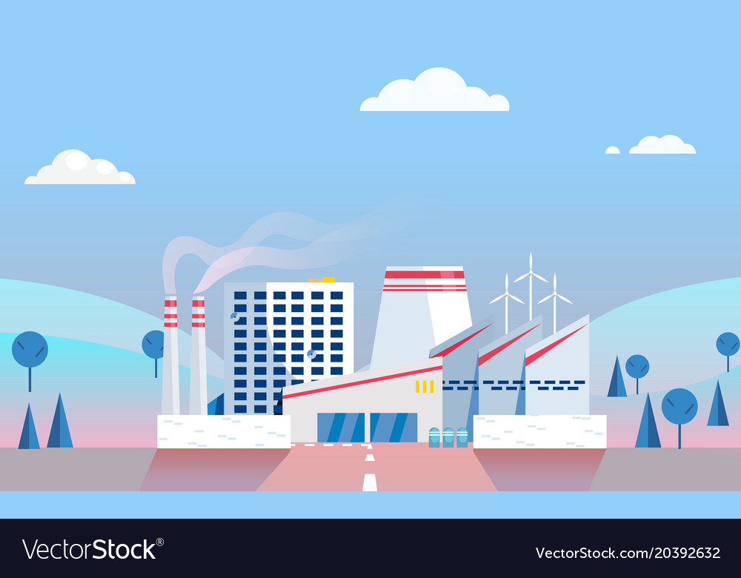
FACTORY METHOD
FACTORY METHOD
GROUP: NHN

Slide 2



<<Interface>>
Transportation
Car
Plane
Boat
TransportationFactory

Slide 3

Factory Method [ OverView]
Factory method is a Creational design pattern, i.e., related to object creation.
Create object without exposing the creation logic to client and the client use the same common interface to create new type of object.
Idea: use a static member-function (static factory method) which creates & returns instances, hiding the details of class modules from user.

Slide 4

STRUCTURE
Super Class: can be a interface, abstract class or normal class.
Sub Classes: implement methods of super class based on its task.
Factory Class: create sub class based on initial argument. Caution: this class is Singleton or provide a public static method for accessing and initializing objects. Factory class uses if-else or switch-case to define output sub class.

Slide 5




without Factory Method
Whenever we need to instantiate an object, we use the new operator as usual:
class Transportation{…};
class Car: public Transportation{…};
class Plane: public Transportation{…};
class Boat: public Transportation{…};
And:
Transportation *pC=new Car;
Transportation *pP=new Plane;
Transportation *pB=new Boat;

Slide 6


Difficulty of the above way
Notes:
Car type name appearing in the invocation of the new operator.
So, if you want to create an object of the type Plane, you have to go to the actual statement and replace Car with Plane. You cannot make the new operator act more dynamically: You must pass it a type, and that type must be exactly known at compile time.
Difficult to manage initialize the object.

Slide 7

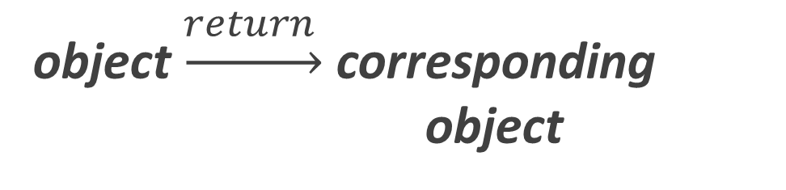
Difficulty of the above way
object
that can handle the initialization of these objects
object $\underset{→}{return }$ corresponding object
Factory object
Notes:
We need an object that can handle the initialization of these objects, just pass the request, then that object will return the corresponding object. To do that we need to use a Factory object.

Slide 8




above problem with Factory Method
Step 1: Create enum to save group of requests
Step 2: Build Factory
Step 3: Using Factory

Slide 9

Other problems solved with Factory Method
‘Drawing’ system, depending on user’s input, different pictures like square, rectangle, circle can be drawn. Here we can use factory method to create instances depending on user’s input.

Slide 10
Other problems solved with Factory Method
Shape
Traingle
Circle
Rectangle
ShapeFactory

Slide 11

Other problems solved with Factory Method
All banks’ system provide API to access to their systems. We need to design a API for client to use service of one bank. At this moment, client just need to use 2 banks’ service: VietcomBank and TPBank. However, to easy to extend in the future, client hope that they don’t have to change code when they use another bank.

Slide 12



Other problems solved with Factory Method
<<interface>>
Bank
TPBank
Client
BankFactory
+ main(): void

Slide 13
Advantages and Disadvantages
* Makes code more difficult to read as all of your code is behind an abstraction that may in turn hide abstractions.
* Reduced readability due to increased abstraction.
* Applicable only for families of classes.
ADVANTAGE
DISADVANTAGE
Hiding implementation of an application seam.
Easy to test the seam of an application certain parts of your application → build & test the other parts
Changing the design of your application more readily → loose coupling.
Application more customizable.
Make the code more difficult to be read.
Reduced readability due to increased abstraction.
Applicable only for families of classes.
Notes:
Seam: the core interfaces that make up your application
Code more difficult to read as all of your code is behind an abstraction that may in turn hide abstractions

Slide 14
@REFERENCE:
http://uttakarshtikku.blogspot.com
https://www.quora.com/
https://www.geeksforgeeks.org/
https://www.stdio.vn/
https://gpcoder.com/4352-huong-dan-java-design-pattern-factory-method/

Slide 15


QUIZ

Slide 16


THANKS FOR WATCHING

